Slide 1



AutoTool: Efficient Tool Selection for Large Language Model Agents
Jingyi Jia, Qinbin Li*
12/28/2025

Slide 2
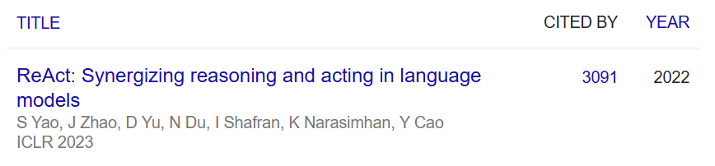



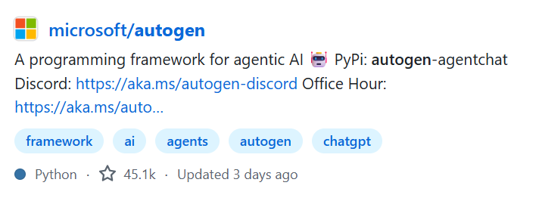
From LLMs to Agents
Background
2
LLMs show explosive growth in capabilities:
understanding, reasoning, complex task automation …
Environment
Memory
Tools/Action

Slide 3
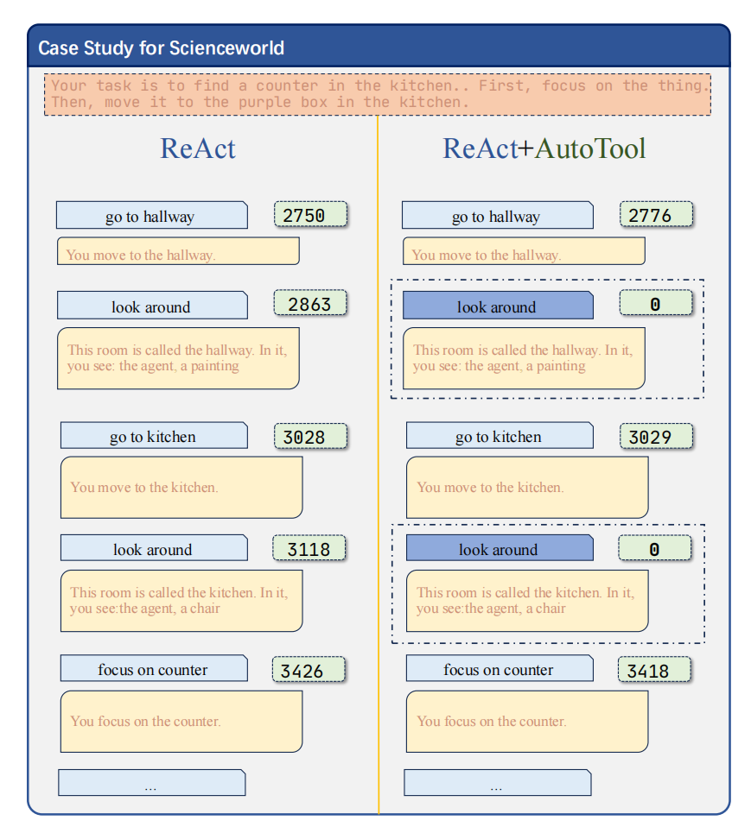
The Problem: High Inference Costs for Tool Selection
Background
3
Fact：frameworks like ReAct repeatedly invoke LLMs for:
Task planning
Tool selection
Parameter generation
Each decision can mean a full LLM call
Significant Resource Consumption & Latency
A major bottleneck in current agent frameworks lies in the high inference cost of tool selection.

Slide 4
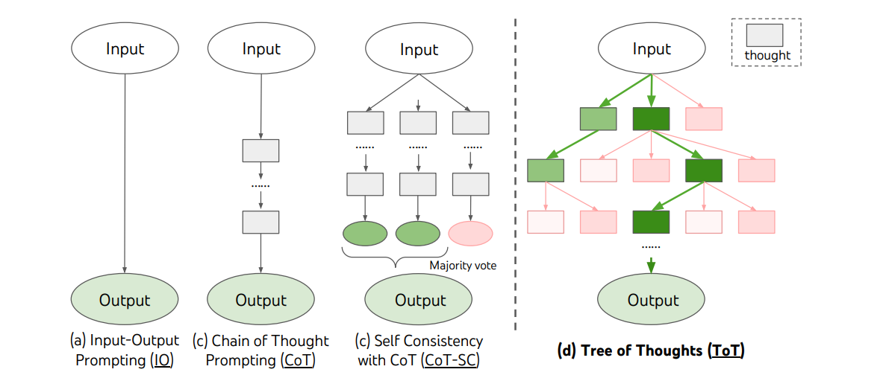
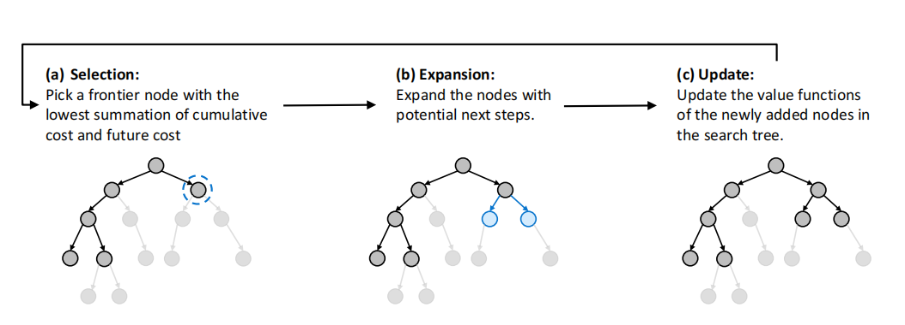
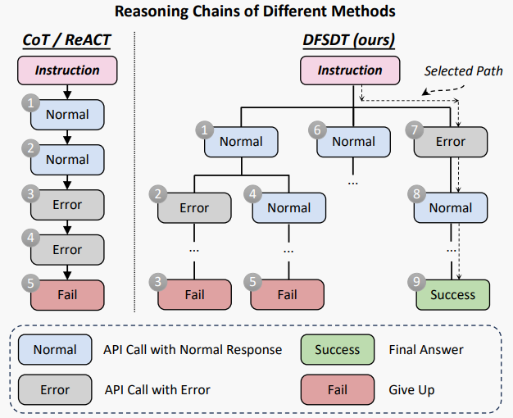
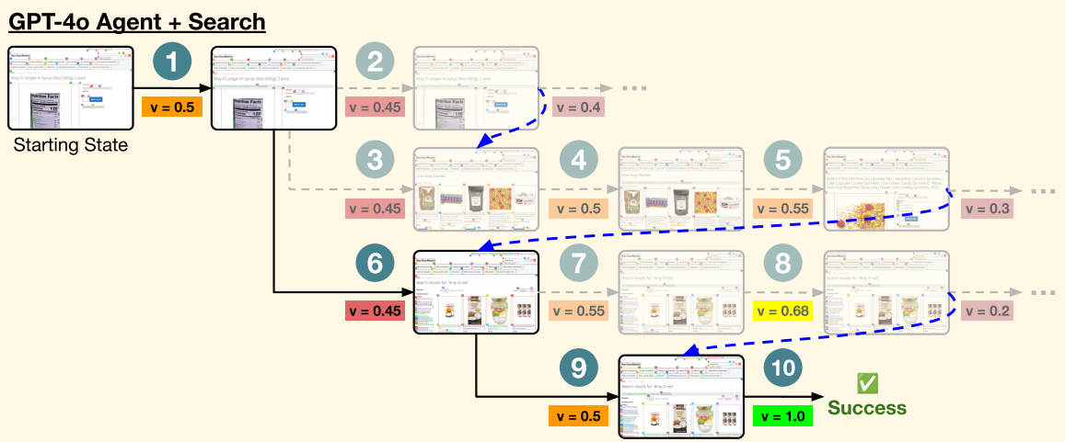
Automated Tool Selection
Background
4
Complex tasks require agents to execute a sequence of interdependent tool calls.
(a) Tree of Thoughts
(b) ToolChain*
(c) DFSDT
(d) Tree Search Agent

Slide 5
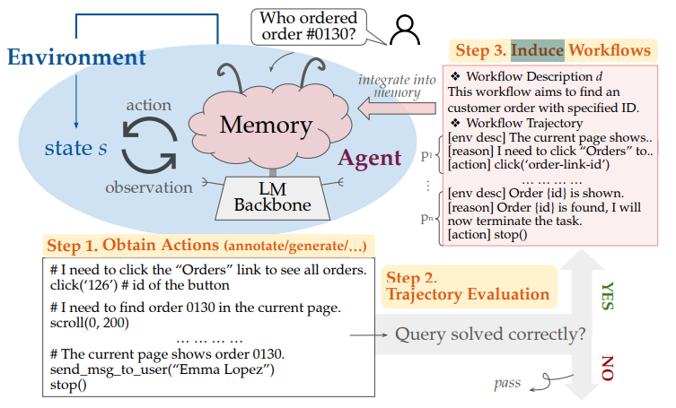
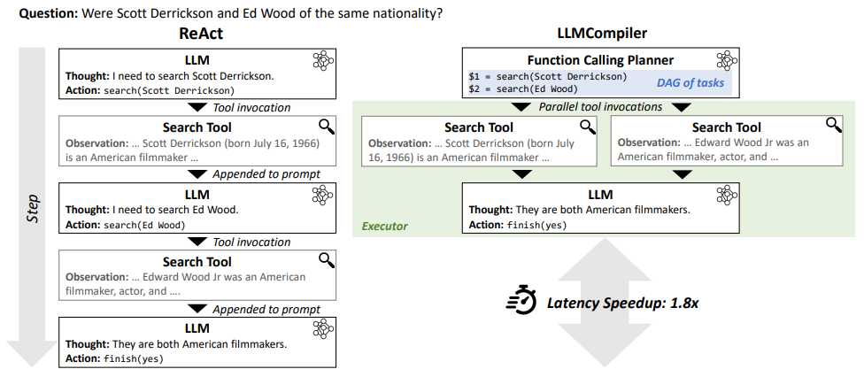
Data-driven and Efficiency-oriented optimization
Background
5
Agent Workflow Memory
An LLM Compiler for Parallel Function Calling
Interesting
Works
Highlights
Extracts reusable workflows to guide web agents
Enabling parallel function calling
Limitations
Context Engineering &
Introduce extra token consumption
Rely on LLM-preconstructed DAGs &
Only optimize logic-parallelizable tool calls.

Slide 6
Recency Bias towards LLMs in Agent Research
Motivation
6
Assumption: Not all decision steps in a task are of equal complexity or importance.
This universal application of a resource-intensive model for both complex and simple decisions constitutes an over-utilization of its powerful abilities, creating unnecessary computational overhead.
Universal reliance on the LLM is not only costly but also suboptimal.
Can we utilize statistical methods instead of relying heavily on LLM inference for every tool selection step?

Slide 7
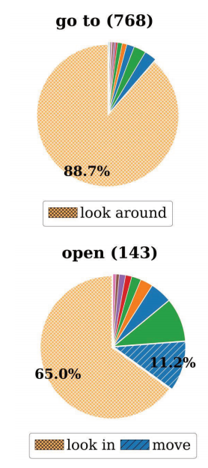
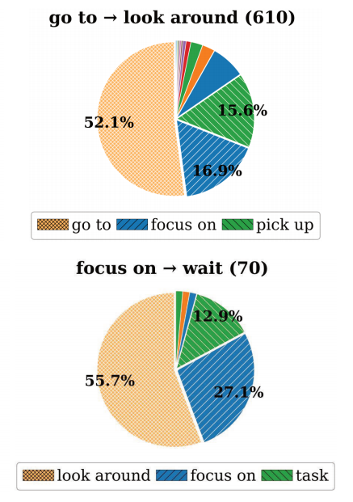
Key Insights: Tool Calling Has Inertia
Motivation
7
Analysis on ScienceWorld
Tool Invocation Exhibits Predictable
- Tool successor analysis
Utilize a ReAct agent within the ScienceWorld
environment to generate 322 trajectories, yielding
6014 tool invocations.
Remove repetitive tool calls (e.g., A → A)
Remove overly short trajectories (length less than 2)

Slide 8
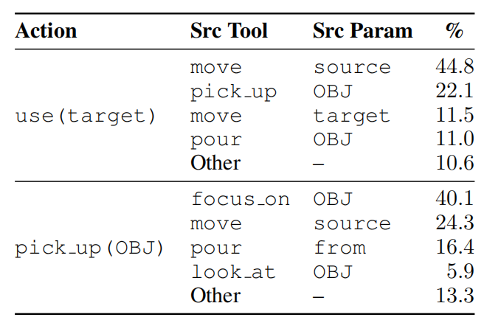
Key Insights: Tool Calling Has Inertia
Motivation
8
Analysis on ScienceWorld
Tool Invocation Exhibits Predictable
- Parameter flow analysis
Utilize a ReAct agent within the ScienceWorld
environment to generate 322 trajectories, yielding
6014 tool invocations.
Remove repetitive tool calls (e.g., A → A)
Remove overly short trajectories (length less than 2)

Slide 9
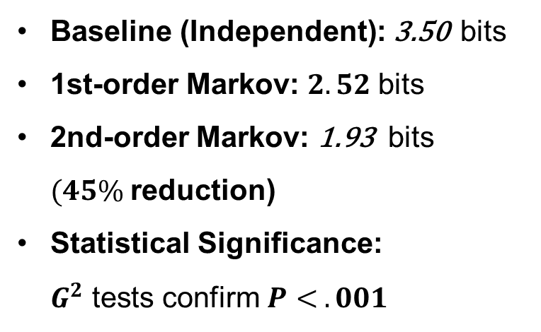
Key Insights: Tool Calling Has Inertia
Motivation
9
Analysis on ScienceWorld
Tool Invocation Exhibits Low Entropy Inertia
Utilize a ReAct agent within the ScienceWorld
environment to generate 322 trajectories, yielding
6014 tool invocations.
Baseline (Independent): 3.50 bits
1st-order Markov: $2.52$bits
2nd-order Markov: 1.93 bits $(45\%$reduction)
Statistical Significance: $G^{2}$tests confirm $P< .001$
Remove repetitive tool calls (e.g., A → A)
Remove overly short trajectories (length less than 2)

Slide 10
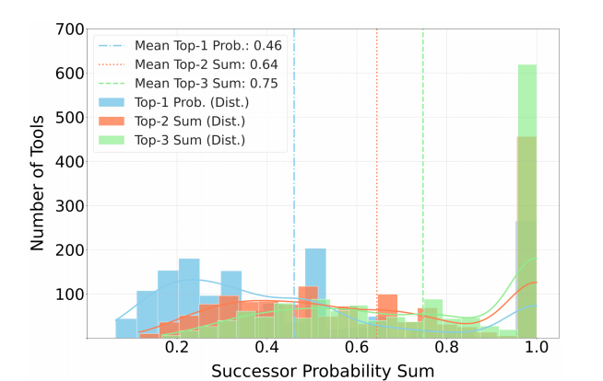
Key Insights: Tool Calling Has Inertia
Motivation
10
Analysis on ToolBench G3
15,000+ valid invocation trajectories
1,595 tools
Remove repetitive tool calls (e.g., A → A)
Remove overly short trajectories (length less than 2)
$$H\left(random\right)= –\left|Tools\right|·\left(\frac{1}{\left|Tools\right|}\right)\log_{2}\left(\frac{1}{\left|Tools\right|}\right)≈\text{10.64 }\text{bits}$$
$$H(Y|X) (measured) = –Σ_{i,j} p(x_{i},y_{j}) log₂ p(y_{j}|x_{i}) ≈ 3.62 bits$$
66 % entropy slashed

Slide 11
Key Insights: Tool Calling Has Inertia
Motivation
11
Premise: tool invocations are not independent events.
Instead, they follow predictable sequential patterns, a phenomenon we call 'tool usage inertia'.
Treats observed tool usage inertia as a behavior to be actively managed.
Many "low-thought-density" tool calls might not require full LLM reasoning. If we can capture this inertia, we can bypass LLM calls and improve efficiency.

Slide 12








Overview
Methodology
12
Before each step, attempt inertial invocation. If both inertia detection and parameter filling succeed, invoke the tool; otherwise, defer to the LLM.
Inertial Sensing
Param Filling
End
Start
Thought
Task intuition
Action
Structed input and output
Obs

Slide 13
Data Structure: Tool Inertial Graph
Methodology
13
AutoTool uses Graph Structure to capture and leverage inertia, thereby reducing token and time consumption.
Edge
Node
Tool Edge
Tool Node
Record tool sequence
Define next candidate tools
Maintain map to tool sequence
Contain tool sematic information
Param Edge
Param Node
Record param source-target pair
Define parameters to fill
Manage the source of current parameter

Slide 14




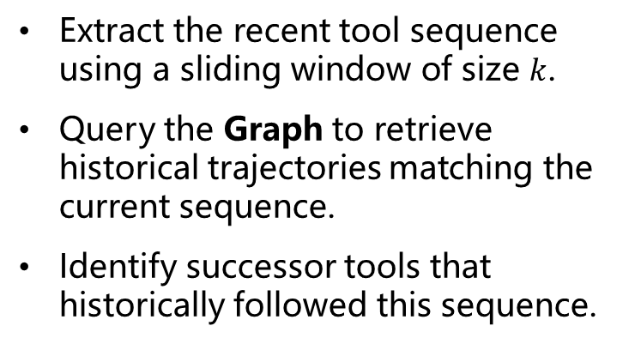
Tool Prediction
Methodology
14
Graph Based Inertial Sensing Strategy
loadAuthorNet
authorNodeCheck
1.Identifying Candidate Tools
loadPaperNet
authorNodeCheck
Extract the recent tool sequence using a sliding window of size $k$.
Query the Graph to retrieve historical trajectories matching the current sequence.
Identify successor tools that historically followed this sequence.
neighbourCheck
Semantic information
Frequency information
Tool intuition
Graph search
2. Calculate Comprehensive Inertia Potential Score (CIPS)
Task intuition
Weight Cal
3. Decision

Slide 15

Tool Prediction
Methodology
15
Graph Based Inertial Sensing Strategy
loadAuthorNet
authorNodeCheck
1.Identifying Candidate Tools
loadPaperNet
authorNodeCheck
2. Calculate Comprehensive Inertia Potential Score (CIPS) Based on：
- frequency inertia confidence score
- contextual relevance score
neighbourCheck
Semantic information
Frequency information
3. Decision:
Select tool with the highest CIPS and compare it with inertial thereshold
If CIPS exceeds thereshold, trigger parameter filling.
Tool intuition
Graph search
Task intuition
Weight Cal

Slide 16


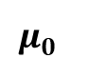

Methodology
Physical Intuition
16
How to let the block slide? From Momentum to Decision
$$F_{environment}$$
$$f_{static}$$
$$F_{momentum}$$
$$μ_{0}$$
$$F_{total}=F_{environment}{+F}_{momentum} >f_{static} ⇒ \text{Inertial} \text{Motion}$$
$$F_{total}=F_{environment}{+F}_{momentum} ≤f_{static} ⇒ \text{External} \text{Force} \text{Required}$$
CIPS${ =(1−α)∙Score}_{freq} + α∙{Score}_{ctx}>θ_{inertial}⇒ \text{Inertial} \text{Call}$
CIPS${ =(1−α)∙Score}_{freq} + α∙{Score}_{ctx}≤θ_{inertial}⇒ \text{LLM} \text{Call}$

Slide 17

Parameter Filling
Methodology
17
Hierarchical Progressive Filling Strategy
authorNodeCheck
loadAuthorNet
1. Fill from Parameter Dependency Edges in TIG
graph_name
node_id
author_name
Backtrack from the target tool's input parameters.
Identify source parameters from previous tools in the execution history (prioritizing current chain).
Out-of-chain param node
2. Fill from Environmental Context / Predefined States
node_name
Some parameters depend on the agent's state or environment
Handled by a dataset-specific "Adaptor" module for flexibility.
graph_name
neighbourCheck

Slide 18
Fault Tolerance Mechanism
Methodology
18
Level 1: Inherent Fallback Mechanism
Revert to LLM Inference
Trigger Conditions for Aborting the Inertial Call
Low confidence score ( CIPS < θ )
Incomplete parameter filling
Level 2: Rate Limiting
Bypass inertial call
No Consecutive Calls
Global Usage Cap (<30%)
Level 3: Pre-configured Recovery Pathway
Force Re-orientation Action
Detect pattern of consecutive failures

Slide 19
Experiment Setting Up
Evaluation
19
Datasets（Based on AgentBoard):
AlfWorld: Text-based interactive home environment (e.g., "put a clean mug in coffee machine").
ScienceWorld: Simulates scientific experiments (e.g., "find animal with longest life span").
ToolQuery-Academic: Academic database queries via predefined APIs.
Baselines: ReAct and Reflexion
We integrate AutoTool with baselines to compare their performance and efficiency.
Core Metrics:
Performance: Progress Rate (PR): Task completion accuracy.
Efficiency:
- Average LLM Calls: measure time consumption
- Average Token Consumption: measure token consumption

Slide 20
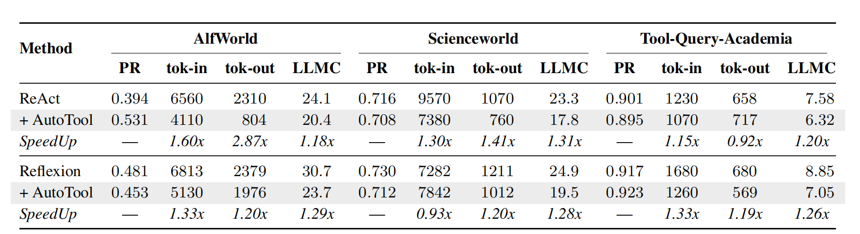
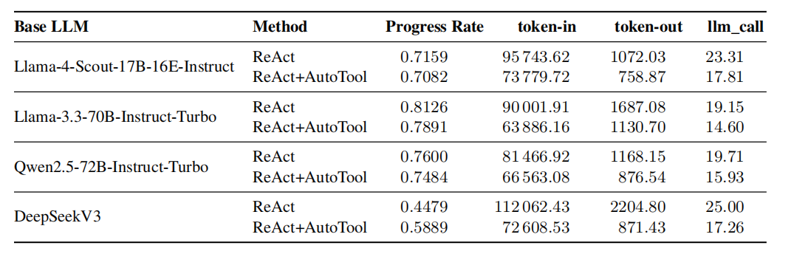
Different Frameworks and Models
Evaluation
20
All experiments are conducted in a pure cold-start setting. The core graph is built online from scratch without any prior trajectories, ensuring fairness across comparisons.
Results:
Reduces LLM calls by ~20% ± 5%
Reduces total token consumption by ~25% ± 15%.
Maintains competitive Progress Rates compared to baselines.
Demonstrates considerable robustness across different models.

Slide 21
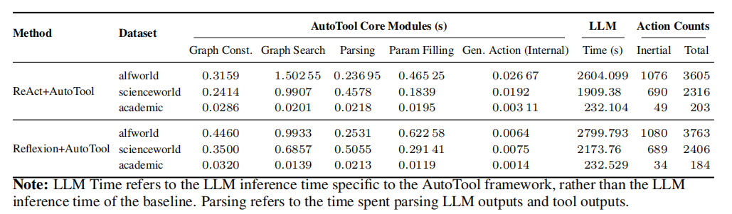
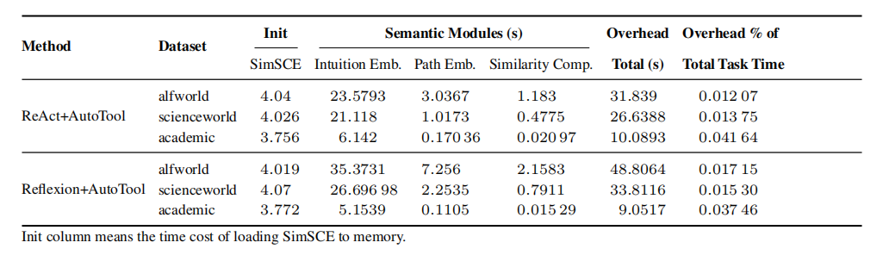
Overhead Analysis
Evaluation
21
Results:
The main overhead comes from text embedding and semantic similarity calculation.
The overhead from other components is negligible.
Total overhead is about 2.8% ± 1.5% of the task execution time.

Slide 22
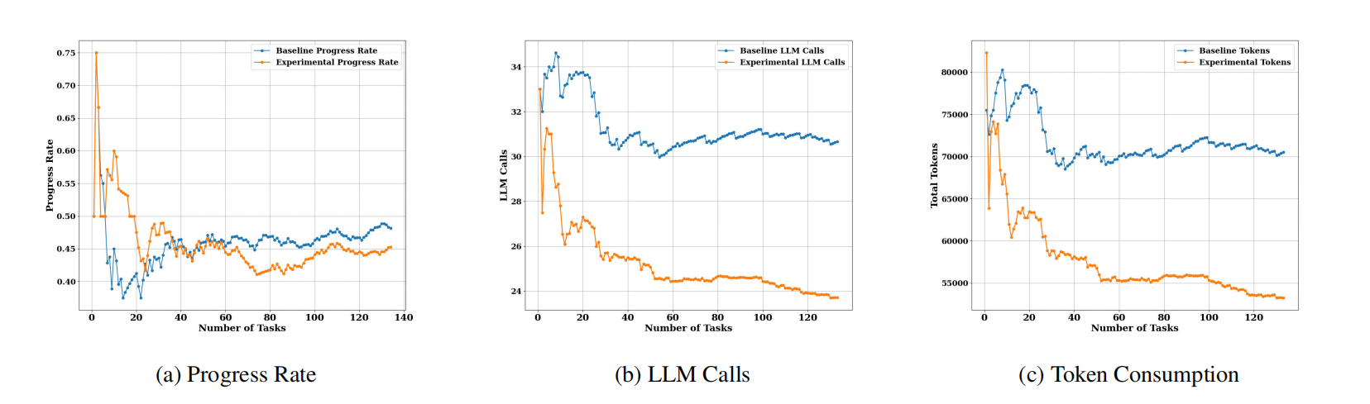
Dynamic Analysis
Evaluation
22
Key Observations
1. After an initial adaptation phase (approx. 80 tasks), performance trend stabilizes and remains comparable to the baseline.
2. Efficiency gap widens over time as the Tool Inertia Graph is continuously refined with more execution trajectories.

Slide 23
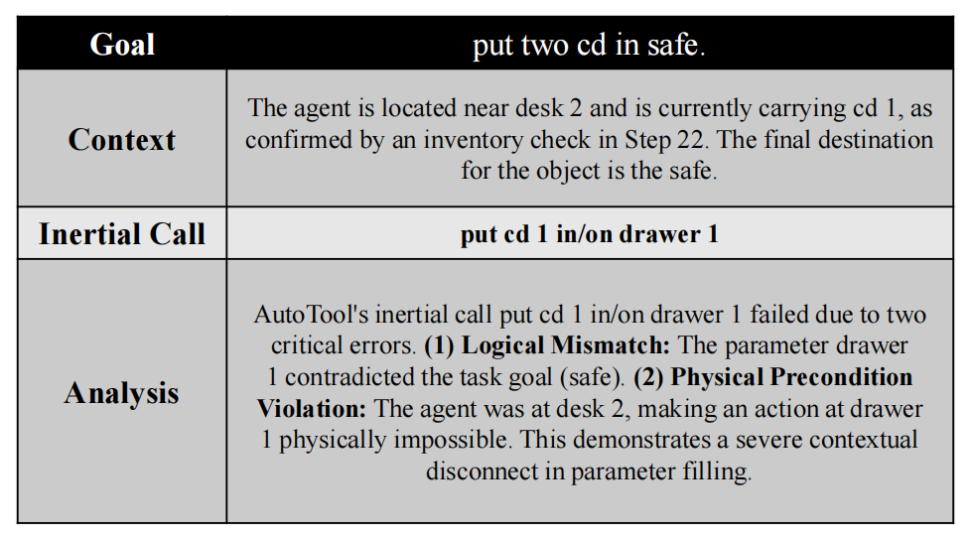
Failure Case Analysis
Evaluation
23
Scenario 1: Parameter Filling with Incorrect Context
Scenario 2: Inertia-Induced Redundant Actions
Scenario 3: Overgeneralization of Tool Usage Patterns

Slide 24
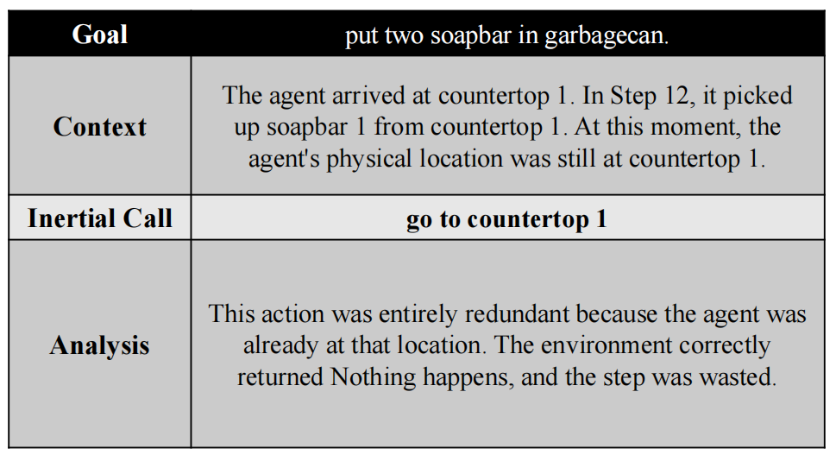
Failure Case Analysis
Evaluation
24
Scenario 1: Parameter Filling with Incorrect Context
Scenario 2: Inertia-Induced Redundant Actions
Scenario 3: Overgeneralization of Tool Usage Patterns

Slide 25
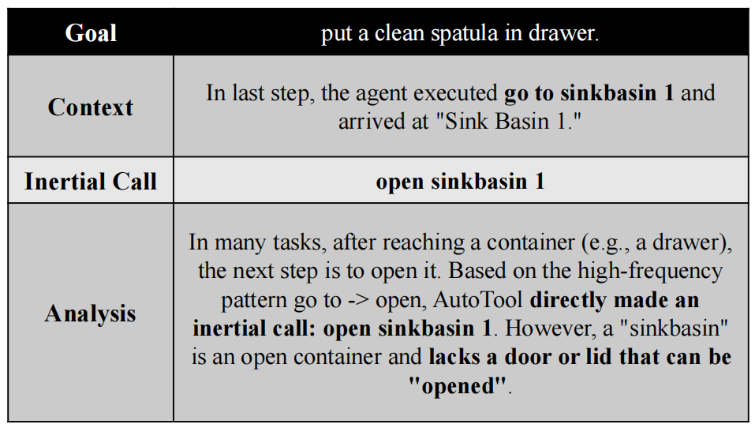
Failure Case Analysis
Evaluation
25
Scenario 1: Parameter Filling with Incorrect Context
Scenario 2: Inertia-Induced Redundant Actions
Scenario 3: Overgeneralization of Tool Usage Patterns

Slide 26
Summary
Summary
26
AutoTool: A Graph-based, efficient tool selection strategy for LLM agents
Core Idea: Leverages "tool usage inertia" to reduce token & time consumption
Mechanism:
Dynamic Tool Inertia Graph (TIG)
Uses TIG to predict & parameterize tools, bypassing LLM calls
LLM fallback for low inertia or prediction failure
Results:
~30% LLM cost reduction (calls & tokens)
Competitive performance maintained
Insights: Statistical structure enables efficient and effective LLM agents

Slide 27

Thanks

